Slide 1

Versions
Current Version: 1.2.4
Version Used: 0.98.3

Slide 2





























Big Data Ecosystem
Streaming Engines
Data Store
Data Processing
Peripherals
Data Services
Distributions
Cloud Exposure

Slide 3
Agenda
Introduction
When to use Hbase
Hbase benefits than RDBMS
HDFS vs HBASE
HBASE vs RDBMS
Architecture
Components
Region Server Components
Zookeeper
Data model
Hbase Storage Model
Creating Table
Operations using Java
Hbase Shell
References
3

Slide 4
Introduction
HBase is a distributed column-oriented data store built on top of HDFS.
HBase is a NoSQL database provides linear scalability, automatic failover support.
It manages the very large tables billions of rows X millions of columns in the clusters of commodity hardware.
HBase is an Apache open source designed to operate on top of the Hadoop distributed file system (HDFS)
4

Slide 5
When to Use Hbase ?
You need random write, random read or both.
You need to do many thousands of operations per second on multiple TB of data.
Your access patterns are well known and simple
5

Slide 6
HBase benefits than RDBMS?
No real indexes.
Automatic partitioning .
Scale linearly and automatically with nodes.
Commodity hardware.
Fault tolerance.
Batch processing.
6

Slide 7
HDFS vs HBASE
.
HDFS | Hbase
HDFS is a distributed file system suitable for storing large files. | HBase is a database built on top of the HDFS.
HDFS does not support fast individual record lookups. | HBase provides fast lookups for larger tables.
It provides high latency batch processing. | It provides low latency access to single rows from billions of records (Random access).
It provides only sequential access of data. | HBase internally uses Hash tables and provides random access.
7

Slide 8
HBASE vs RDMS
Hbase | RDMS
HBase is schema-less, it doesn't have the concept of fixed columns schema; defines only column families. | An RDBMS is governed by its schema, which describes the whole structure of tables.
It is built for wide tables. HBase is horizontally scalable. | It is thin and built for small tables. Hard to scale.
No transactions are there in HBase. | RDBMS is transactional.
It has de-normalized data. | It will have normalized data.
It is good for semi-structured as well as structured data. | It is good for structured data.
.
8

Slide 9
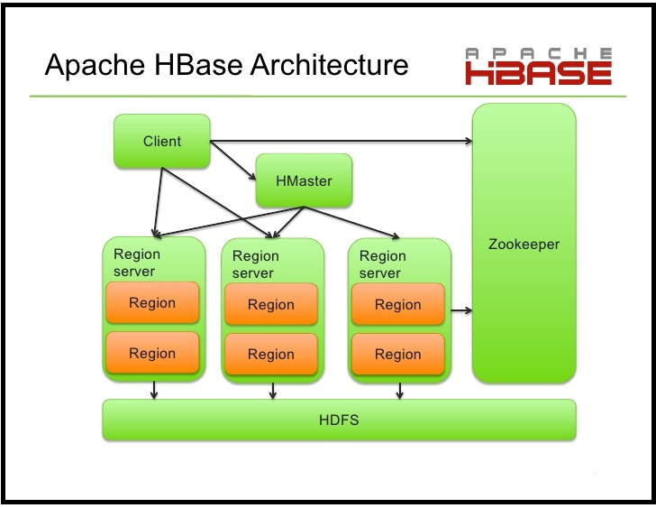
Architecture
9

Slide 10
Components
Hmaster:
Master server is the responsible for monitoring all region server instances. Region assignment, DDL (create, delete tables) operations are handled by the HBase Master process.
Region server:
Communicate with the client and handle data-related operations.
Handle read and write requests for all the regions under it.
Regions:
Regions are nothing but tables that are split up and spread across the region servers.
Notes:
10

Slide 11
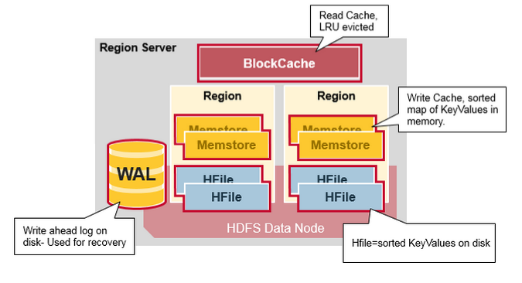
Region Server Components
Region Server runs on an HDFS data node and has the following components.
WAL: Write Ahead Log is a file on the distributed file system.It is used to store new data that hasn't yet been persisted to permanent storage.It is used for recovery in the case of failure.
BlockCache: is the read cache. It stores frequently read data in memory. Least Recently Used data is evicted when full.
MemStore: is the write cache. It stores new data which has not yet been written to disk. It is sorted before writing to disk. There is one MemStore per column family per region.
Hfiles store the rows as sorted KeyValues on disk.
Notes:
11

Slide 12
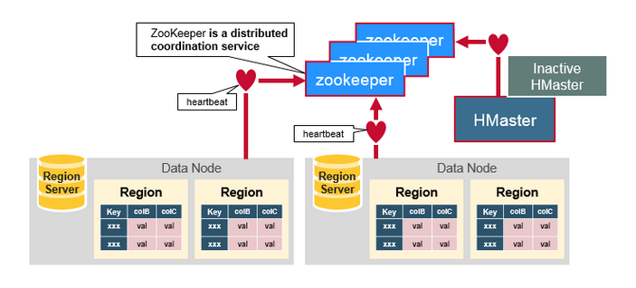
Zookeeper :The Coordinator
HBase uses ZooKeeper as a distributed coordination service to maintain server state in the cluster.
It maintains which servers are alive and available, and provides server failure notification.
Notes:
12

Slide 13
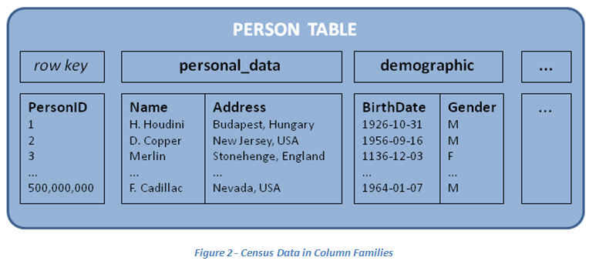
Data Model
Table: HBase organizes data into tables.
Row: Within a table, data is stored according to its row. Rows are identified uniquely by their row key. Row keys do not have a data type and are always treated as a byte[ ].
Each record is divided into
Column Families
Each row has a Key
Column Family: Data within a row is grouped by column family. Column families also impact the physical arrangement of data stored in HBase. For this reason, they must be defined up front and are not easily modified.
Each column family
consists of one or more Columns
13
Notes:
13

Slide 14
Data Model
Column Qualifier: Data within a column family is addressed via its column qualifier, or simply, column. Column qualifiers need not be specified in advance. Column qualifiers need not be consistent between rows. Like row keys, column qualifiers do not have a data type and are always treated as a byte[ ].
Each record is divided into
Column Families
Each row has a Key
Cell: A combination of row key, column family, and column qualifier uniquely identifies a cell. The data stored in a cell is referred to as that cell’s value. Values also do not have a data type and are always treated as a byte[ ].
Each column family
consists of one or more Columns
14
Notes:
14

Slide 15
HBase Storage Model
Partitioning
- A table is horizontally partitioned into regions, each region is composed of sequential range of keys - Each region is managed by a RegionServer, a single RegionServer may hold multiple regions
Persistence and data availability.
- HBase stores its data in HDFS, it doesn't replicate RegionServers and relies on HDFS replication for data availability.
- Region data is cached in-memory
Updates and reads are served from in-memory cache (MemStore)
MemStore is flushed periodically to HDFS
Write Ahead Log (stored in HDFS) is used for durability of updates
Notes:
15

Slide 16
Creating Table
Creating the Hbase Table
Table HBaseAdmin admin= new HBaseAdmin(config);
HColumnDescriptor []column;
column= new HColumnDescriptor[2];
column[0]=new HColumnDescriptor("columnFamily1:");
column[1]=new HColumnDescriptor("columnFamily2:");
HTableDescriptor desc= new TableDescriptor(Bytes.toBytes("MyTable"));
desc.addFamily(column[0]);
desc.addFamily(column[1]);
admin.createTable(desc);
Notes:
16

Slide 17
Operations using Java
Operations on Regions : Get().
Configuration config = HBaseConfiguration.create();
HTable class HTable table = new HTable(config, "emp");
Get g = new Get(Bytes.toBytes("row1"));
Result result = table.get(g);
byte [] value = result.getValue(Bytes.toBytes("personal"), Bytes.toBytes("name"));
byte [] value1 = result.getValue(Bytes.toBytes("personal"),Bytes.toBytes("city”);
String name = Bytes.toString(value);
String city = Bytes.toString(value1);
Notes:
17

Slide 18
Operations using Java
Operations on Regions : Put().
Configuration config = HBaseConfiguration.create();
HTable hTable = new HTable(config, "emp");
Put p = new Put(Bytes.toBytes("row1"));
p.add(Bytes.toBytes("personal"), Bytes.toBytes("name"),Bytes.toBytes("raju")); p.add(Bytes.toBytes("personal"), Bytes.toBytes("city"),Bytes.toBytes("hyderabad")); p.add(Bytes.toBytes("professional"),Bytes.toBytes("designation"),Bytes.toBytes("manager"));
p.add(Bytes.toBytes("professional"),Bytes.toBytes("salary"), Bytes.toBytes("50000"));
hTable.put(p);
hTable.close();
Notes:
18

Slide 19
Operations using Java
Operations on Regions : Scan().
HTable table = new HTable(config, "emp");
Scan scan = new Scan();
scan.addColumn(Bytes.toBytes("personal"), Bytes.toBytes("name")); scan.addColumn(Bytes.toBytes("personal"), Bytes.toBytes("city ResultScanner scanner = table.getScanner(scan);
for (Result result = scanner.next(); result != null; result = scanner.next())
System.out.println("Found row : " + result);
scanner.close();
Notes:
19

Slide 20
Hbase shell
Hbase shell provides interactive commands for manipulating database.
Create/delete tables.
Ex: create 'test' ,'f1';
disable 'test';
drop 'test';
Insert/update/read from tables.
Ex: put 'test',90,'f1:name','zzz';
put 'test',90,'f1:name','yyy';
get 'test',90;
Notes:
20

Slide 21
Hbase shell
Filters in Hbase
SingleColumnValueFilter
scan 'airline' ,{ FILTER =>"SingleColumnValueFilter('flightbetween','source',=, 'binary:hyd')" }
QualifierFilter
scan 'airline',{ FILTER =>"QualifierFilter(=,'binary:flightno')"}
PrefixFilter
scan 'airline', {FILTER => "(PrefixFilter ('row2'))"}
Notes:
21

Slide 22
Reference
Hbase site : https://hbase.apache.org/
Downloading Hbase: http://redrockdigimark.com/apachemirror/hbase/
Documentation:
HBASE: https://hbase.apache.org/book.html

Slide 23


Test Yourself
Answer the following questions:
What is apache Hbase?
Give the name of the key components of Hbase.
Define column families?
What are the operational commands of Hbase?
Hbase is a distributed column-oriented database
Operational commands of Hbase are Get, Delete, Put, Increment, and Scan..
Which code is used to open the connection in Hbase?
Zookeeper, Region Server, Region, and Hbase Master.
Configuration myConf = HBaseConfiguration.create();
HTable usersTable = new HTable(myConf, “users”);
Which type of data hbase can store?
It is a collection of columns whereas row is a collection of column families.
Hbase can store any type of data that can be converted into bytes.

Slide 24
Questions?

Slide 25
Assignment
Install Hbase
Create table in Hbase
Perform CRUD operations using java and command line

